Slide 1
Mobile and Wireless Technology CT090-3-2-MWT Version VD01
WLAN Infrastructure Devices

Slide 2
Topic & Structure of The Lesson
Access Points (AP)
Autonomous Access Points
Lightweight Access Points
Mesh Access Points
Wireless LAN Routers
Wireless Bridges
Wireless Repeaters
Wireless LAN Controller/Switch

Slide 3
Learning Outcomes
At the end of this topic, You should be able to
Remember the function and features of three different access point technologies.
Understand differences in various infrastructure devices.
Explain the function of other infrastructure devices.

Slide 4
Key Terms You Must Be Able To Use
If you have mastered this topic, you should be able to use the following terms correctly in your assignments and exams:
Access point - autonomous and Light weight
Wireless bridges
Wireless controllers/switches
Wireless LAN routers
Wireless mesh networking
Wireless repeaters

Slide 5
Topic & Structure of The Lesson
Access Points (AP)
Autonomous Access Points
Lightweight Access Points
Mesh Access Points
Wireless LAN Routers
Wireless Bridges
Wireless Repeaters
Wireless LAN Controller/Switch

Slide 6
Access Point
In order for computers and other network devices to communicate with one another, a communication infrastructure of some type is necessary.
In a wired network, such an infrastructure consists of cables, repeaters, bridges, and Layer 2 switches.
In a wireless network, these devices are access points, bridges, and repeaters. All will be discussed in more detail
in this chapter.
The AP provides computers and other wireless devices access to the local area network using RF (Radio Frequency) as the connection medium.

Slide 7
Access Point
The access point (AP) is a major player in the wireless LAN network infrastructure. Access points are available in three types that are:
Autonomous
Lightweight
Mesh

Slide 8
Topic & Structure of The Lesson
Access Points (AP)
Autonomous Access Points
Lightweight Access Points
Mesh Access Points
Wireless LAN Routers
Wireless Bridges
Wireless Repeaters
Wireless LAN Controller/Switch

Slide 9
Access Point – Autonomous Access Point
Autonomous AP’s were the first type of access points that were introduced onto the wireless market.
These were perfect for small scale wireless network solutions that needed no more than 10-15 clients per access point or were just providing “hot-spot” type of services.
Each fat AP needs to be manually configured for the network and security settings you would want running on your network. This is a great solution if you only plan on having a few AP’s.

Slide 10
Access Point – Autonomous Access Point
Any more than that just was not scalable.
No administrator wants to have to manually configure multiple devices – thus the need for a change.

Slide 11
Access Point – Autonomous Access Point
Listed here are some of the features in SOHO-grade access points:
IEEE 8 NN 02.11 standards support
Wi-Fi certifications
Removable antennas
Static output power
Security
Bridge functionality
Repeater functionality
DHCP server
Configuration and settings options

Slide 12
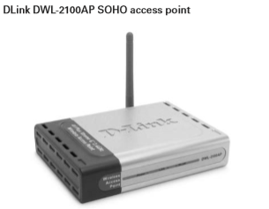
Access Point – Autonomous Access Point (SOHO Access Point)

Slide 13
Access Point – Autonomous Access Point
Enterprise access points typically have a much more extensive feature set than the previously mentioned SOHO access points.
Enterprise-grade access points can include the following features:
IEEE 8 NN 02.11 standards support
Wi-Fi certifications
Removable or expandable antennas
Adjustable transmit output power
Advanced security
Multiple operation modes, including root, bridge, and repeater capabilities
Command-line interface (CLI) configuration

Slide 14
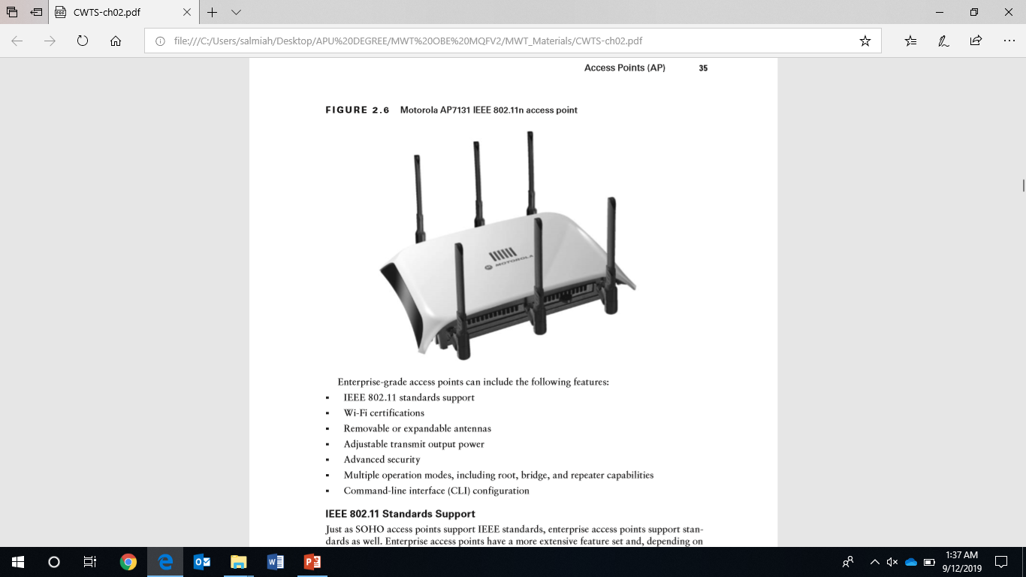
Access Point – Autonomous Access Point (Enterprise Access Point)

Slide 15
Topic & Structure of The Lesson
Access Points (AP)
Autonomous Access Points
Lightweight Access Points
Mesh Access Points
Wireless LAN Routers
Wireless Bridges
Wireless Repeaters
Wireless LAN Controller/Switch

Slide 16
Access Point – Lightweight Access Point
Lightweight access points differ from autonomous access points in that they are used with wireless LAN controllers/switches and not as standalone devices.
Lightweight access points have shifted much of the intelligence to the wireless LAN controller/switch.
Since a lightweight access point contains less intelligence than an autonomous access point, the cost of a lightweight access point can be significantly lower.

Slide 17
Access Point – Lightweight Access Point
Depending on the manufacturer, lightweight access points may have a more extensive feature set than autonomous access points, and include many of the features of those devices. Lightweight access points are centrally managed from the wireless LAN controller/ switch.

Slide 18
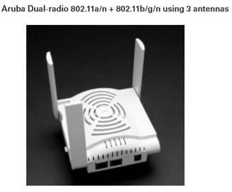
Access Point – Lightweight Access Point

Slide 19
Topic & Structure of The Lesson
Access Points (AP)
Autonomous Access Points
Lightweight Access Points
Mesh Access Points
Wireless LAN Routers
Wireless Bridges
Wireless Repeaters
Wireless LAN Controller/Switch

Slide 20
Access Point – Mesh Access Point
Wireless mesh networking is growing at a steady pace. The term mesh networking has been in existence for many years. In a full mesh network, all nodes connect together with at least two paths for every node.
This allows for reliable communications in the event of a device or path failure.
Wireless mesh networking is very popular in the outdoor market. Some examples where wireless mesh networks are currently utilized are:
Metropolitan
University campuses

Slide 21
Access Point – Mesh Access Point
Public safety
Transportation
Government
Amphitheaters

Slide 22
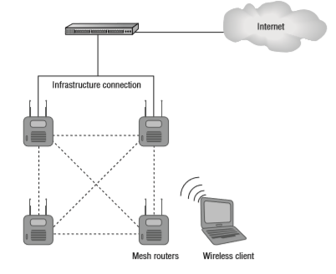
Access Point – Mesh Access Point

Slide 23
Topic & Structure of The Lesson
Access Points (AP)
Autonomous Access Points
Lightweight Access Points
Mesh Access Points
Wireless LAN Routers
Wireless Bridges
Wireless Repeaters
Wireless LAN Controller/Switch

Slide 24
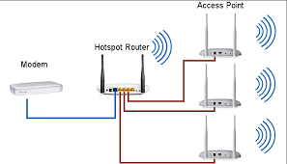
Wireless LAN Routers

Slide 25
Wireless LAN Routers
Wireless LAN routers can be defined differently depending upon the application. In the SOHO or home market, a wireless LAN router may also be known as a wireless broadband router.
The CWNP program and associated material refer to these devices as wireless residential gateways.
In the enterprise environment, a wireless LAN router may have similar functionality plus extended features, and may be known as a wireless VPN router.

Slide 26
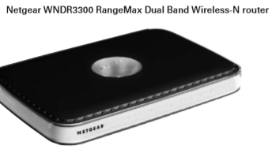
Wireless LAN Routers

Slide 27
Wireless LAN Routers- Wireless Residential Gateway
SOHO or home broadband routers (also known as wireless residential gateways) are usually equipped with an Internet port, several ports for an Ethernet switch, and a wireless access point.
These routers are configured through a web browser using either the HTTP or the HTTPS protocol. Configuration of the devices is fairly simple for the novice user using web browser via a built-in web server.
In most cases, a broadband wireless router connects to either a cable modem or a digital subscriber line (DSL) connection available from an Internet service provider (ISP).

Slide 28
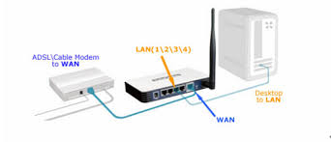
Wireless LAN Routers- Wireless Residential Gateway

Slide 29
Wireless LAN Routers- Wireless VPN Router
A wireless VPN router typically has three ports available: Ethernet port to connect to a LAN
Internet port to connect to the wide area network (WAN) Wireless port to allow IEEE 802.11 computers and devices to connect to a network
Wireless VPN routers have a more extensive feature set than wireless broadband routers, including Layer 3 VPN tunnels between devices and the router on each side acting as a VPN endpoint.

Slide 30
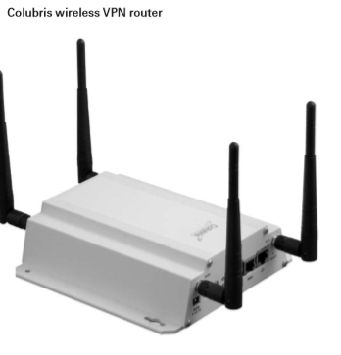
Wireless LAN Routers- Wireless VPN Router

Slide 31
Topic & Structure of The Lesson
Access Points (AP)
Autonomous Access Points
Lightweight Access Points
Mesh Access Points
Wireless LAN Routers
Wireless Bridges
Wireless Repeaters
Wireless LAN Controller/Switch

Slide 32
Wireless Bridge
Wireless bridges connect two or more wired LANs together.
A wireless bridge is a dedicated device that functions in much the same way as an access point in bridge mode.
Wireless bridges have many of the same features as enterprise access points, including removable antennas and selectable power levels.
Connecting locations together using wireless bridges has many benefits, including fast installation, cost savings, and high data transfer rates. Depending on the circumstances, a wireless bridge can be installed in as little as one day.

Slide 33
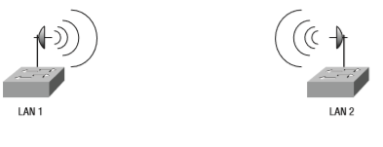
Wireless Bridge

Slide 34
Wireless Bridge
Wireless bridges work in either the 2.4 GHz ISM or 5 GHz UNII band. The distance can span long distances. Since wireless bridges can potentially span long distances, it is important to take security into consideration.
Cost savings can be enormous compared to installing and maintaining a physical wired connection between locations, such as copper, fiber optics, or a leased line from a service provider.

Slide 35
Topic & Structure of The Lesson
Access Points (AP)
Autonomous Access Points
Lightweight Access Points
Mesh Access Points
Wireless LAN Routers
Wireless Bridges
Wireless Repeaters
Wireless LAN Controller/Switch

Slide 36
Wireless Repeaters
Wireless repeaters are used to extend the radio frequency cell. In a wired Ethernet network, repeaters function at Layer 1 of the OSI model to extend the Ethernet segment.
An Ethernet repeater lacks intelligence—that is, it cannot determine data traffic types and simply passes all data traffic across the device.
Just as an Ethernet segment has a maximum distance for successful data transmission, wireless LANs do as well. A wireless repeater provides the ability for computers and other devices to connect to a wireless LAN even though they are not within the normal hearing range of the access point connected to the network.

Slide 37
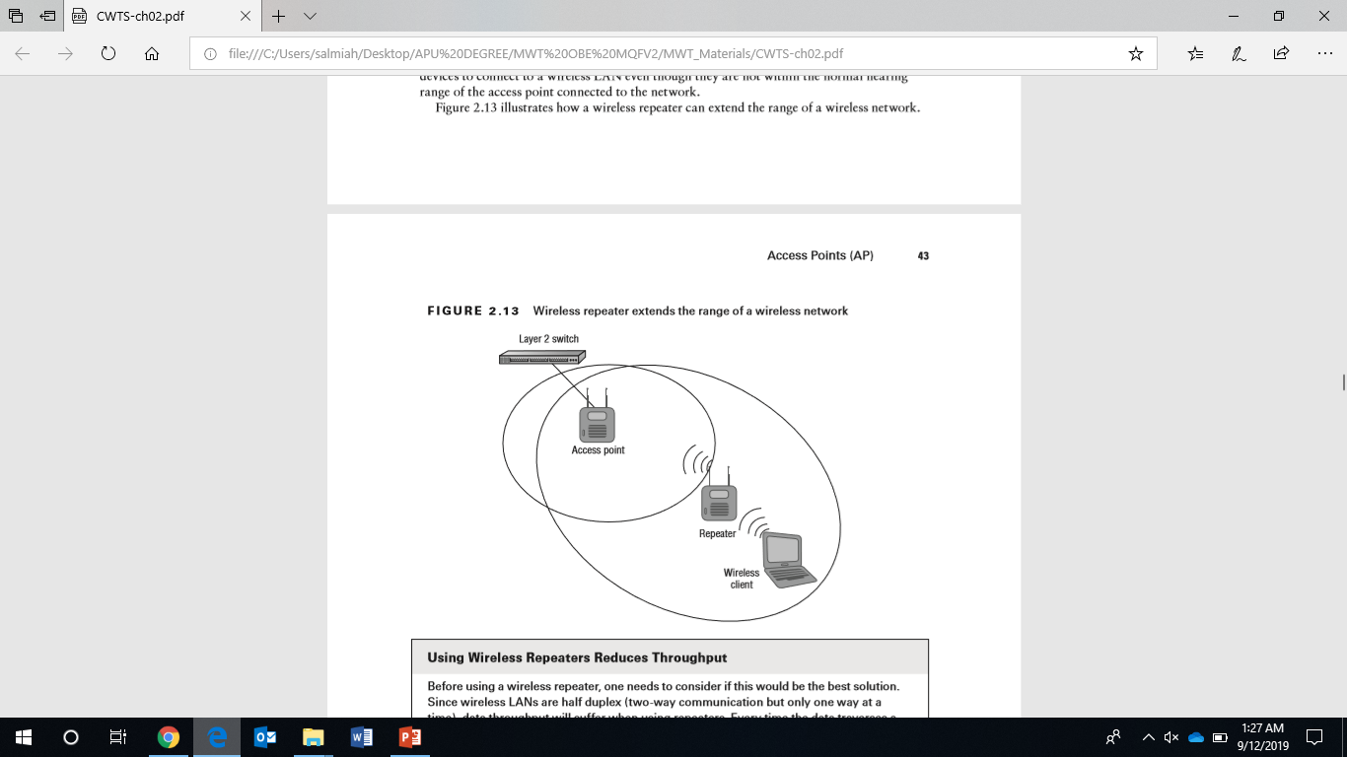
Wireless Repeaters

Slide 38
Topic & Structure of The Lesson
Access Points (AP)
Autonomous Access Points
Lightweight Access Points
Mesh Access Points
Wireless LAN Routers
Wireless Bridges
Wireless Repeaters
Wireless LAN Controller/Switch

Slide 39
Wireless Controllers/Switches
Wireless controllers/switches are growing in popularity in wireless LAN deployments.
Wireless LAN controllers/switches range from branch office models with a few lightweight access points to large scale enterprise devices with hundreds or thousands of lightweight access points.
The branch office models are typically used in remote office installations or small/ medium business (SMB) applications with a limited number of access points.

Slide 40
Wireless Controllers/Switches
Listed here are some of the many benefits, features, and advantages that may be available on wireless LAN controllers/switches.
Virtual LAN (VLAN)
Power over Ethernet (PoE) capability
Improved roaming
Security profiles
Captive portal
Built-in RADIUS services
Site survey tools

Slide 41
Wireless Controllers/Switches
Radio frequency spectrum management
Firewall
Quality of service
Redundancy
Intrusion prevention system (IPS)
Direct or distributed AP connectivity
Layer 2 and Layer 3 AP connectivity

Slide 42
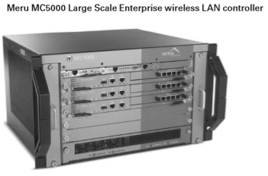
Wireless Controllers/Switches

Slide 43
Quick Review Question
Briefly explain three types of access points.

Slide 44
Summary of Main Teaching Points
This chapter discussed wireless LAN infrastructure devices that are commonly used to provide wireless connectivity to a network for computers and other wireless devices.
This chapter include the access point—the heart of the wireless LAN—available either as a self contained intelligent (autonomous) device or as a lightweight device for use with a wireless
This chapter explained LAN controllers/switches providing user access to network resources, other infrastructure devices include wireless LAN routers for SOHO or home use, wireless bridges for connecting LANs together, and wireless repeaters for extending the RF cell.

Slide 45
Question and Answer Session
Q & A

Slide 46
What we will cover next
Radio Frequency (RF) Fundamentals for Wireless LAN Technology
Frequencies Used for Wireless LANs
Coverage and Capacity
Channel Reuse and Co-location
Basic Units of RF Measurement
RF Range and Speed
Environment: RF Behavior

